Slide 1
Modeling Income with Linear Mixed Effect Model
By Benjamin Stano

Slide 2
Income in America
The Problem:
What are the most important income-determining factors in America?
Quantify how these factors affect income?
The Solution:
Importance-Based Random Forest Feature Selection
Descriptive Linear Mixed Effect Modeling

Slide 3
Other Available Models
Focus on Linear Mixed Effect modeling in this project
Other possible models to use
Pareto distribution model works well to model income
Not well-supported with mixed effects
Random Forest Mixed Effect has higher overall accuracy
No insight into how features interact

Slide 4
Contents
Data Introduction
Feature Selection Method using Random Forest
Mixed Effect Modeling Results
Analysis and Conclusions

Slide 5
Part 1: Introducing the Data

Slide 6
General Social Survey Data
American social survey
Biannual since 1972
Broad range of topics, focus on work life
Each survey year with different feature set
Use 8 most recent years
Outcome: respondent's personal income
Income scaled to 1986 inflation
Shared years data set: 407 Features, 24350 Respondents
Datasets 2000-2016 (8 years) : http://gss.norc.org/get-the-data/spss

Slide 7
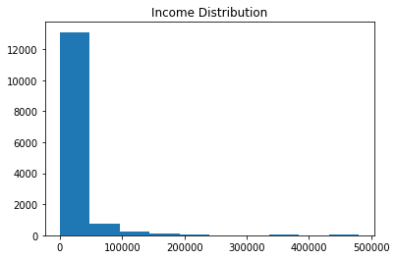
Income Distribution
9,000 (37.5%) respondents removed, no data
Distribution is far from normal
Number of Values
Income Value

Slide 8
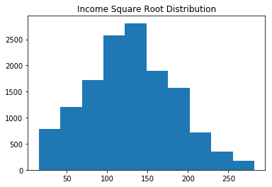
Transforming Income
Remove high earners (outliers) limiting max income to $113k
Square Root of the Income
Much more normally distributed for analysis
Modeling will relate to square root of Income
Number of Values
Square Root Income Value

Slide 9
Feature Selection

Slide 10
Reducing Feature Size
Linear Mixed Effect (LME) models easily overburdened
406 total features to 4 total
Complex categorical data does not mix with linear model
Create binary dummy variables
PCA does not lend itself to descriptive modeling
Use Random Forest to determine feature importance, most important features

Slide 11
Feature Selection Process
Drop non-linear continuous features
Drop categorical features with too many non-answers
Keep all features with more than 0.1% correlation with outcome
Keep feature importance from Random Forest model
Using importance to drop multi-collinear features
Re-run random forest for final importances

Slide 12
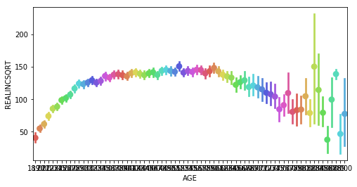
Age vs. Income
Age and Income are related
Correlation of 0.18
Relationship not linear
Age will be the control group for LME model
Respondent Age and Income
Square Root of Income
Age (18-81 years)

Slide 13
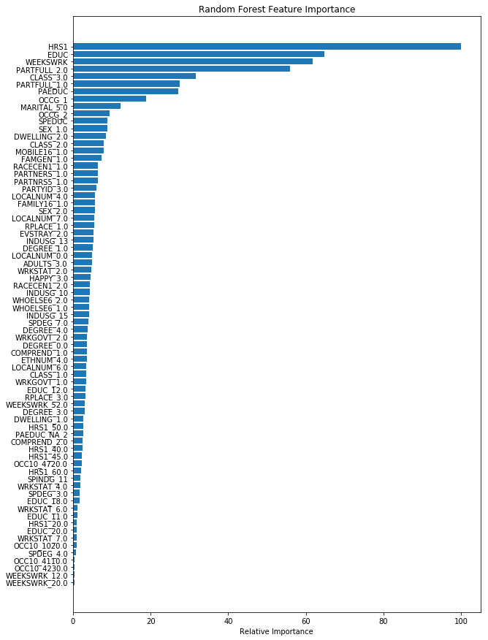
Feature Selection Results
4 Most Important Features:
Education Level
Hours per Week
Weeks per Year
If the person works part-time
3 continuous, 1 categorical

Slide 14
Feature Set Test Modeling
Feature Set is consistent enough to use LME on
Model Used | Random Forest |  | Gradient Boosted Trees |  | OLS Regression
Training Score | 0.623 |  | 0.489 |  | 0.370
Testing Score | 0.342 |  | 0.410 |  | 0.389
CV Score | 0.323 |  | 0.400 |  | 0.367

Slide 15
Part 3: Linear Mixed Effect Modeling

Slide 16
Linear Mixed Effect Modeling
Descriptive model for groups within a population
Uses fixed and random effects
Fixed effects, trends the whole population follows
Random effect, trends group members follow
Use Respondent Age as group
Age has an ICC of 20%
Must determine random effect configuration
Compare configurations with likelihood ratio test
4 features and the intercept can be random or fixed
31 different random effect configurations

Slide 17


LME Random Effect Configuration
A Linear model without mixed effects:
where a, b, c, and d are coefficients calculated by the model
But I am using and Linear Mixed Effect model
Best configuration was Random Education and Part-time
General Linear Equation With Random Effects:
Where and are the coefficients for education and part time given a person’s age
Average value of a and d respectively

Slide 18
LME Assumptions
LME models require 5 assumptions to be met:
Dependency between group members
Age has an ICC of more than 20%
Features are linearly related
Residuals are normally distributed
Residuals have constant variance
Residuals are independent (Homoscedastic)

Slide 19
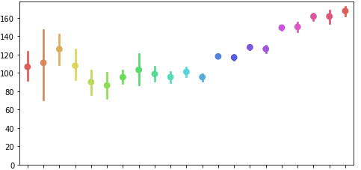
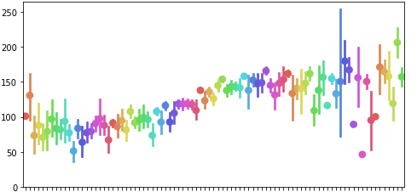
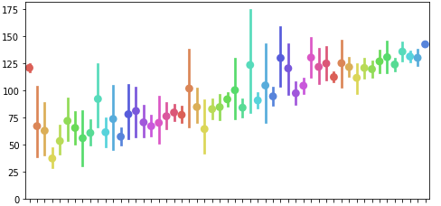
Linearity of Continuous Features
All continuous features have a near linear relationship with the square root of the income
Square Root of Income
Income vs. Education Level
Years of Education (0-20 years)
Income vs. Hours Worked
Square Root of Income
Square Root of Income
Income vs. Weeks Worked
Average Hours Worked per Week (0-80+ hours)
Average Weeks Worked per Year (0-52 weeks)

Slide 20
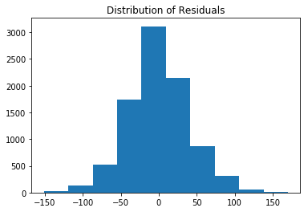
Checking Model Residuals
Check error distribution among income values
Error is normally distributed
Next, look at error distribution among features
Education, Part-Time, Hours, Weeks
Number of Values
Predicted Income Value

Slide 21
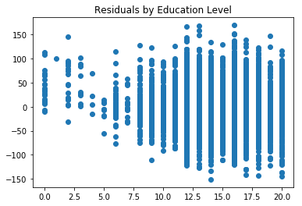
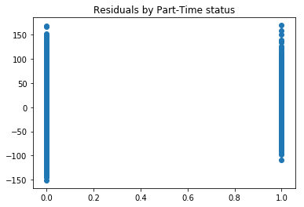
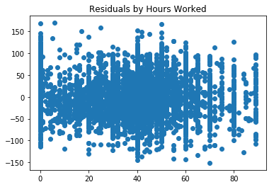
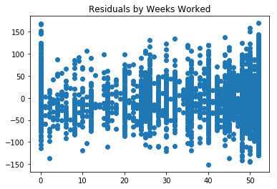
Checking Model Residuals II

Slide 22
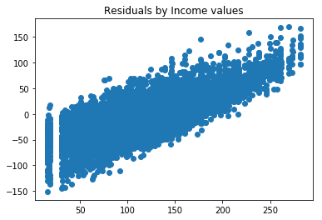
Checking Model Residuals III
Finally, test error among all values of income
Error is not homoscedastic
Focus for future model improvement
Predicted Income Value
Real Income Value

Slide 23
Results and Conclusions

Slide 24
Fixed Effect Model Results
Feature | Coefficient | Standard Error
Intercept | 15.057 | 2.578
Education | 5.159 | 0.223
Hours | 0.544 | 0.025
Weeks | 0.627 | 0.030
Part-Time | -40.764 | 1.734
Income limit $113k, set to 1986 inflation
Square Root Income:
Base of 15.044
Increases by 5.161 for each additional year of formal education
Increases by 0.544 for each additional hour worked per week
Increases by 0.627 for each additional week worked per year
Goes down by 40.771 if part-time job

Slide 25


Mixed Effect Model Results
Feature | Coefficient | Group Variance
Intercept | 15.057 | n/a
Education | 5.159 | 1.462
Hours | 0.544 | n/a
Weeks | 0.627 | n/a
Part-Time | -40.764 | 78.848
Education and Part-Time fluctuate the most between different ages
Coefficients with random effects represent the average among all ages
Education low variance,
Effect education relatively similar between ages
Part-Time has extremely high variance
Effect being part-time has has income varies widely between ages
where and have an average value of 5.159 and -40.764 respectively

Slide 26
Numerical part-time example
Average income of 2 high school graduates, working 40 hour weeks and 51 week years, where one works part-time and the other does not:
Same education and work time, but non-part time makes $17,000, part-time $8,000
Part-time worker makes less than half

Slide 27
Summary Takeaways
4 most important income factors: education, hours, weeks, part-time
Factor affect have been quantified
Being a part-time worker is extremely detrimental to income
Education, working part time effects differ more between age than base income, hours per week, and weeks per year effects
Model can be improved, Fixing heteroscedasticity
Overpredicts low income, underpredicts high income, imbalance between rich and poor is even greater

Slide 28
References
Dataset
http://gss.norc.org/
http://gss.norc.org/documents/codebook
Other Resources
ci.columbia.edu/ci/premba_test/c0331/s7/s7_5.html
stat.ncsu.edu/people/bloomfield/courses/st732/02-21.pdf
stats.stackexchange.com/questions/267325
stats.stackexchange.com/questions/141619
https://statisticalmodeling.wordpress.com/2011/06/23/the-pareto-distribution/

Slide 29
Appendix

Slide 30
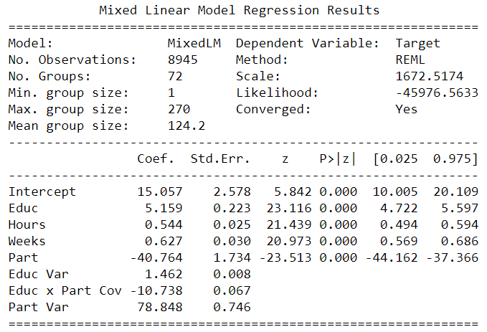
LME Raw Results

Slide 31
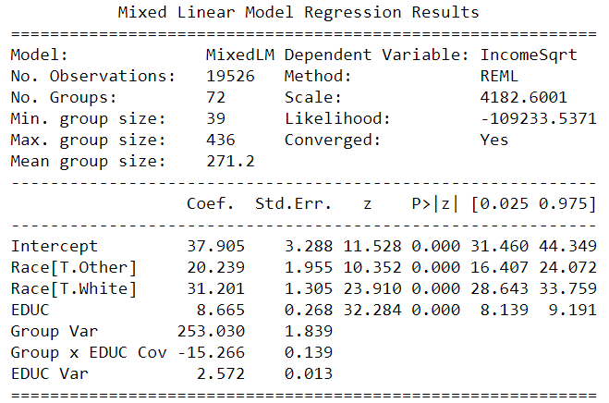
Income, Education, and Race LME
Predicted Income with Education and Race, when controlling for Age
Race used: white, black, other
Black became intercept

Slide 32
Income, Education, and Race results
Years of Education | Black | White | Other
5 | $6,598 | $12,641 | $10,296
6 | $8,081 | $14,664 | $12,129
7 | $9,714 | $16,838 | $14,113
8 | $11,497 | $19,162 | $16,247
9 | $13,430 | $21,636 | $18,531
12 | $20,131 | $29,959 | $26,284
16 | $31,168 | $43,158 | $38,724
20 | $44,608 | $58,761 | $53,566

Slide 33
Questions?

